Slide 1
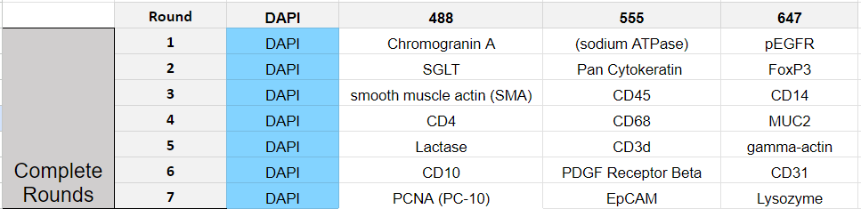
Current Labeling Panel

Slide 2
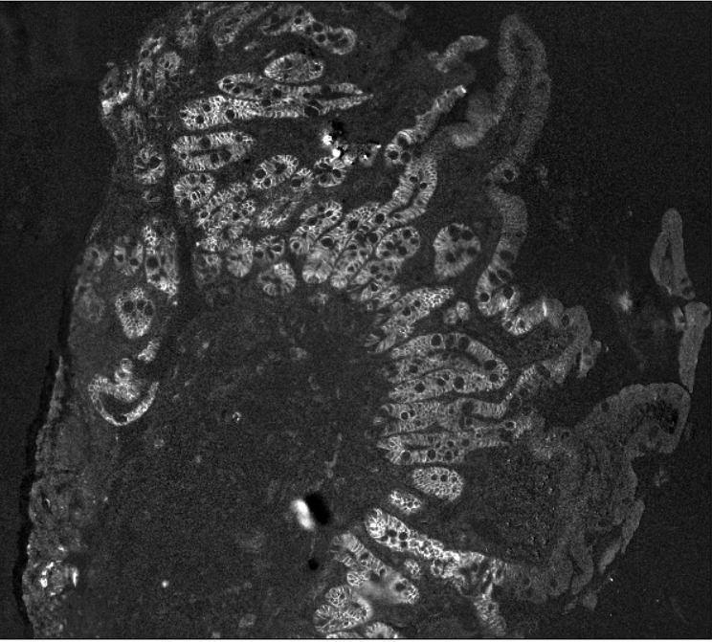
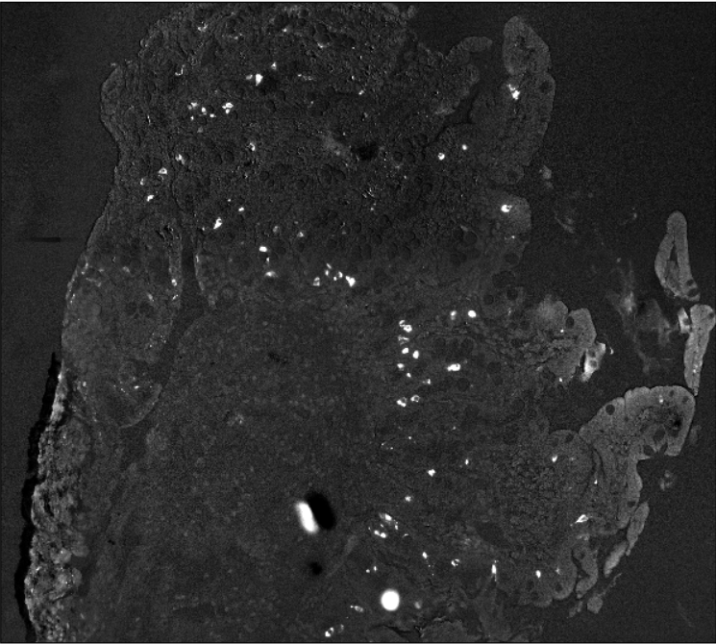
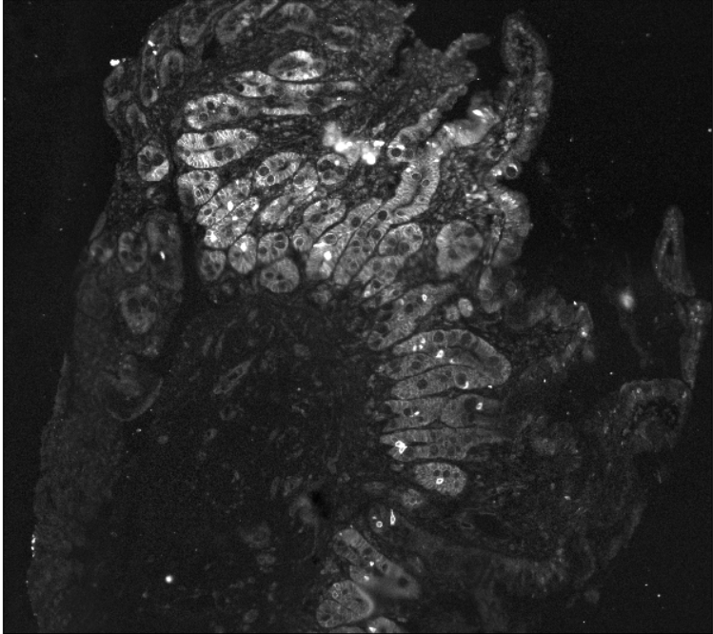
Round 1:
Abcam Sodium Potassium ATPase AF 555 (AB274883) - 1:250 dilution
Multiplex Run 12_12_23
Abcam pEGFR AF 647 (AB205828) - 1:100 dilution
Multiplex Run 12_12_23
Novus Chromogranin A AF 488 (NBP2- 47850AF488) - 1:500 dilution
Multiplex Run 12_12_23

Slide 3
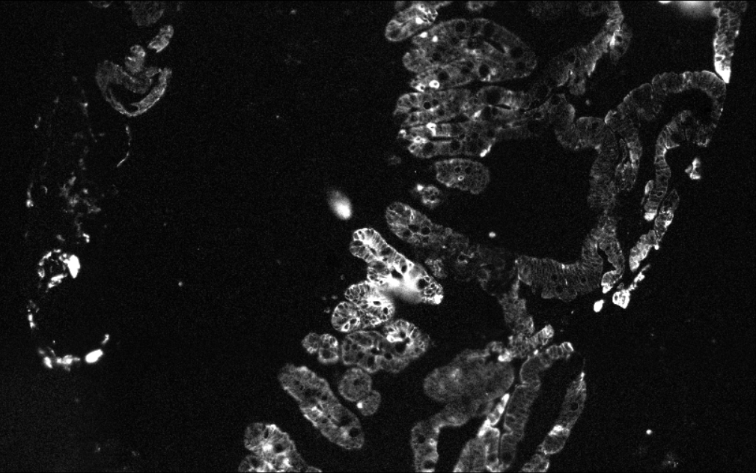
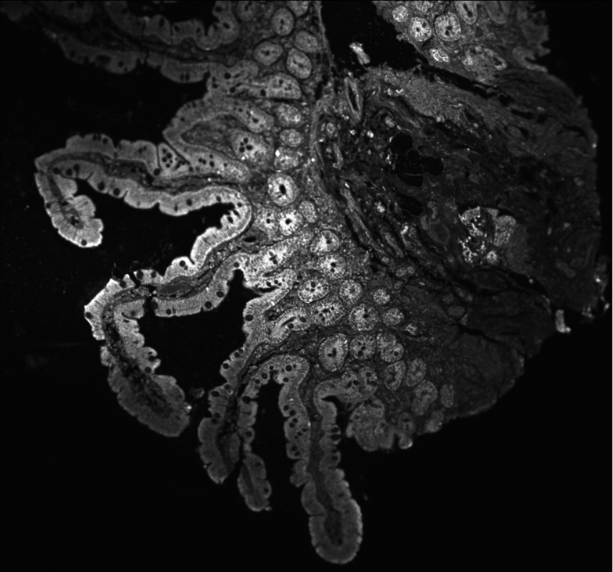
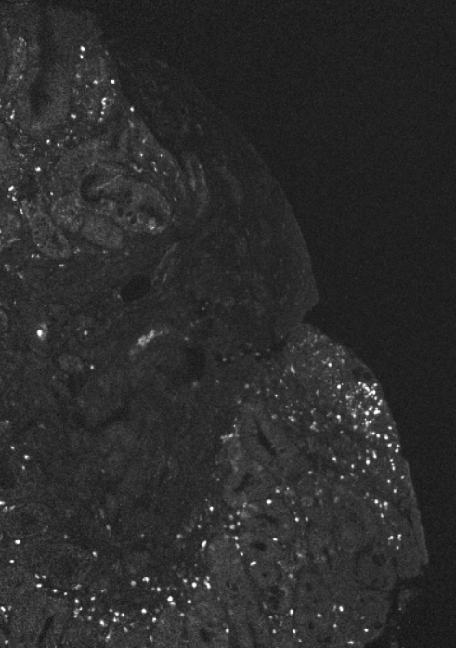
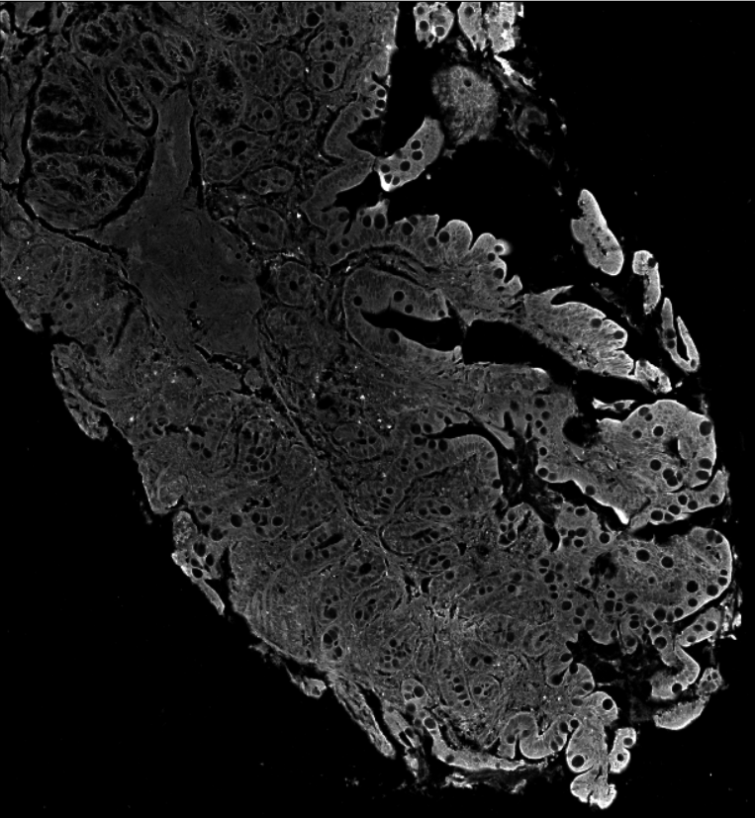
Round 2:
eBioscience Pan CytoKeratin AF 555 (41-9003-82) - 1:100 dilution
Multiplex Run 12_12_23
Primary & Secondary
BioLegend FOXP3 AF 647 (320113) - 1:20 dilution
Andor BC43
488 conjugation
Novus SGLT AF 488 (NBP2-27569) - 1:50 dilution
Andor BC43

Slide 4
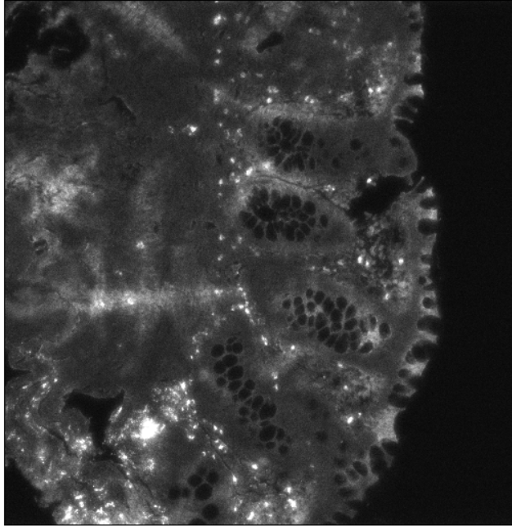
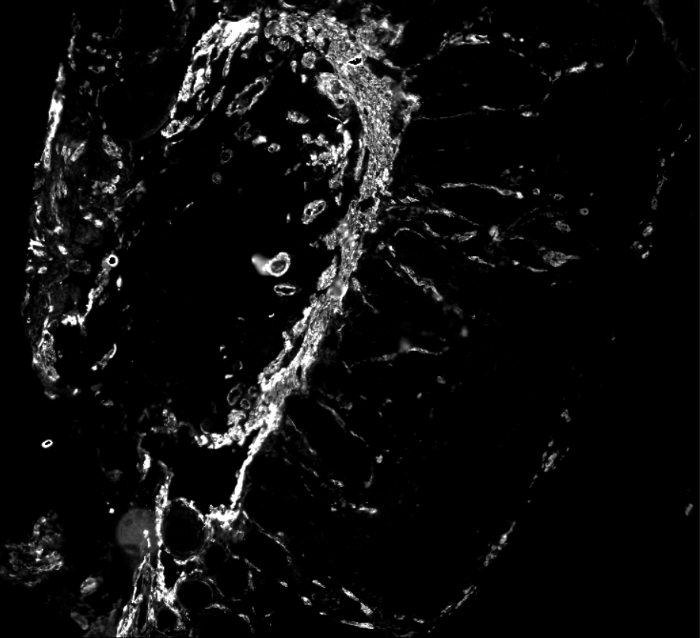
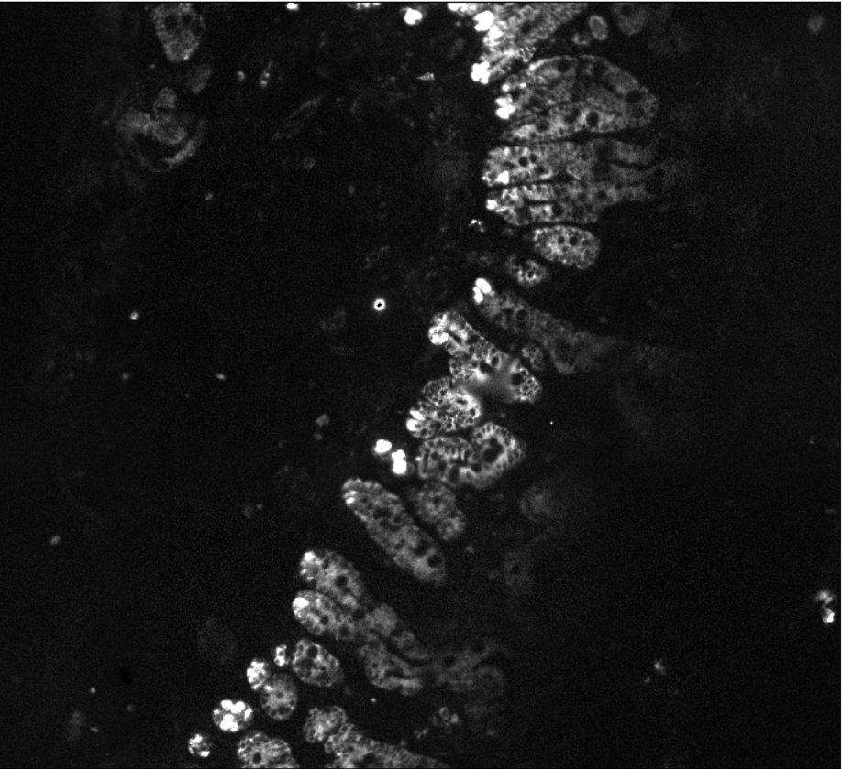
Round 3:
CST CD45 AF 555 (19581S) - 1:50 dilution
Leica Thunder
Abcam CD14 AF 647 (ab302829) - 1:20 dilution
Multiplex Run 12_12_23
Abcam Smooth Muscle Actin AF 488 (AB202295) - 1:250 dilution
Multiplex Run 12_12_23

Slide 5
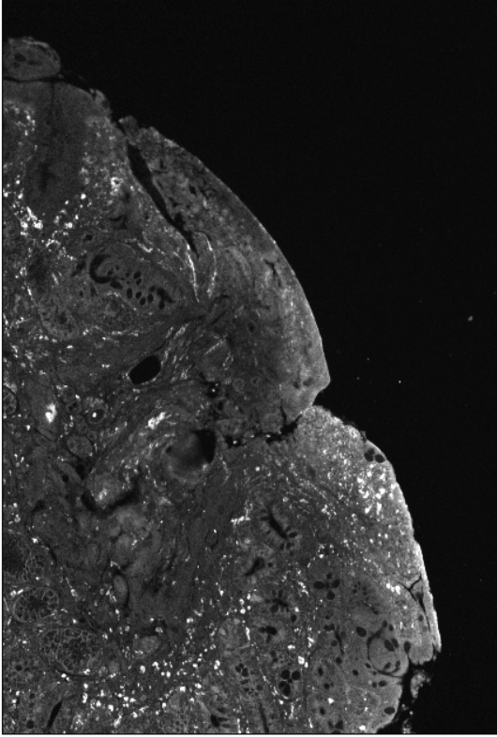
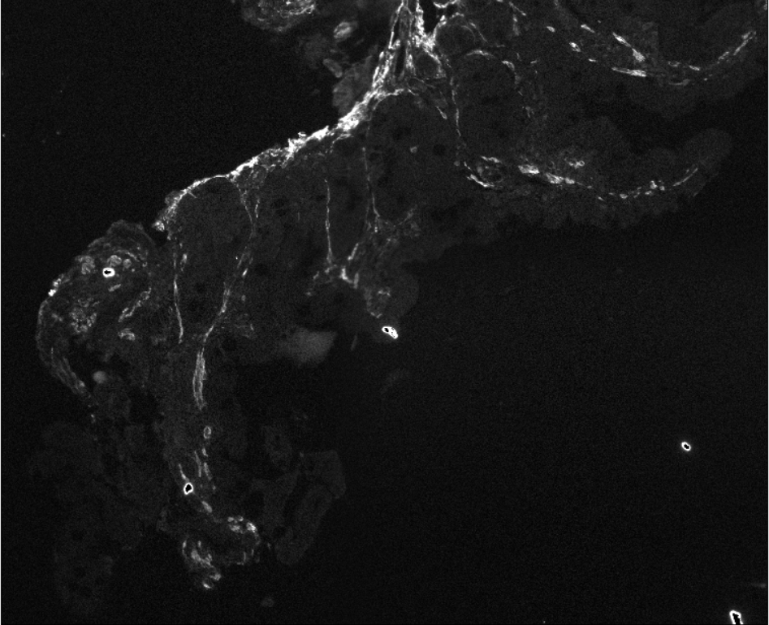
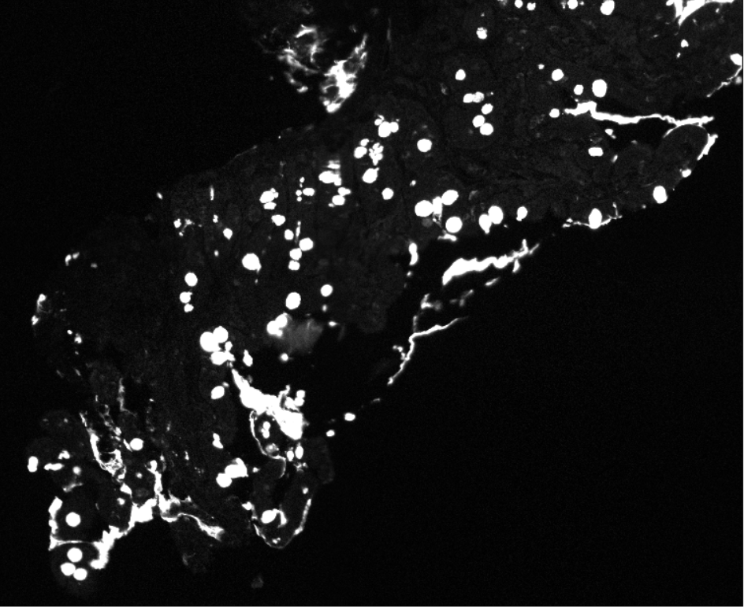
Round 4:
CST CD68 AF 555 (23308S) - 1:50 dilution
Andor BC43
Abcam MUC2 AF 647 - 1:1000 dilution
Multiplex Run 12_12_23
R&D Systems CD4 AF 488 - 1:50 dilution
Multiplex Run 12_12_23

Slide 6
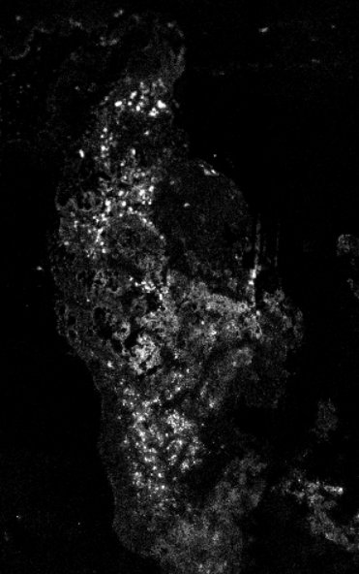
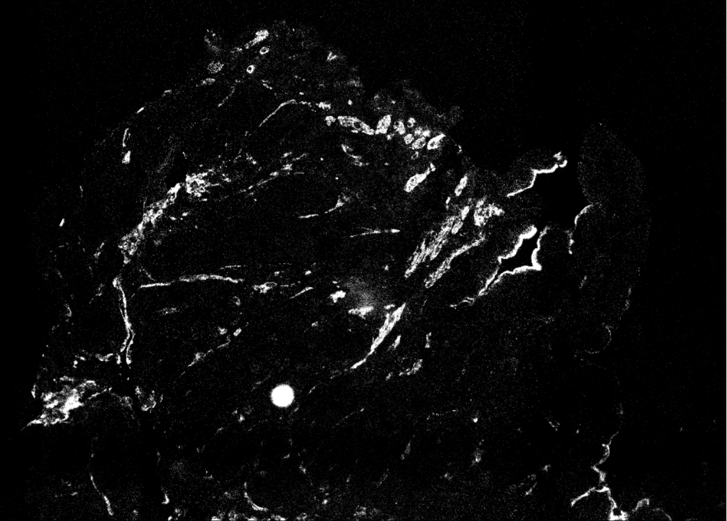
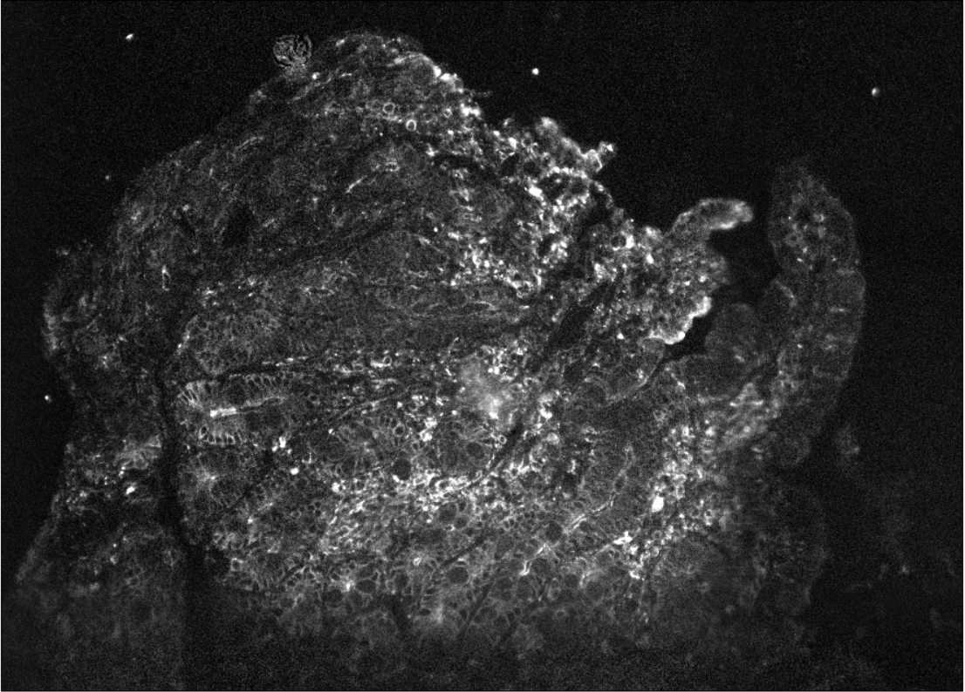
Round 5:
CD3d AF 555 () - 1:50 dilution
Leica Thunder
SCB gamma actin AF 647 - 1:100 dilution
Multiplex Run 12_12_23
Novus Lactase AF 488 - 1:250 dilution
Multiplex Run 12_12_23

Slide 7
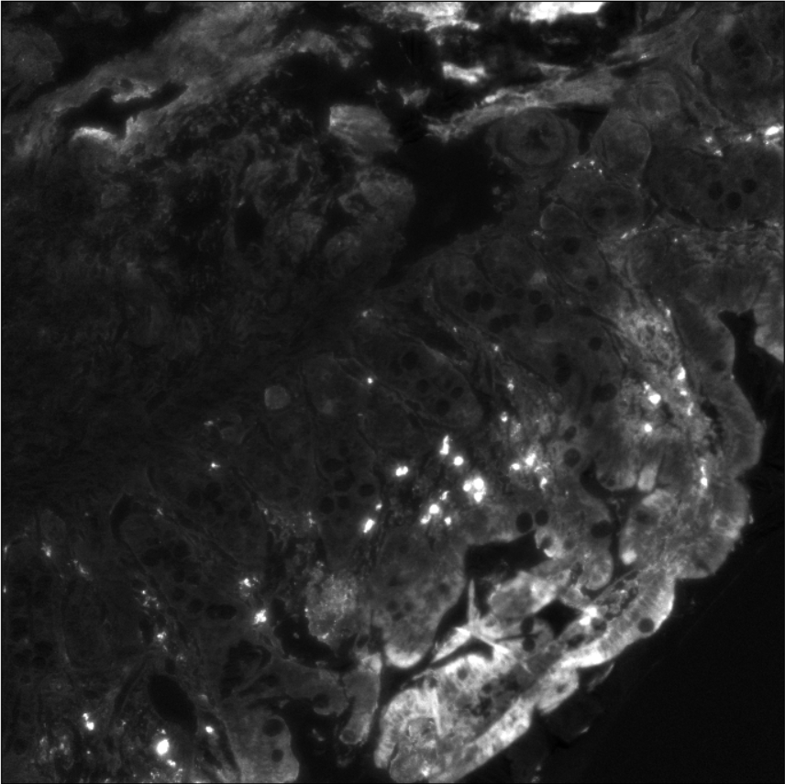
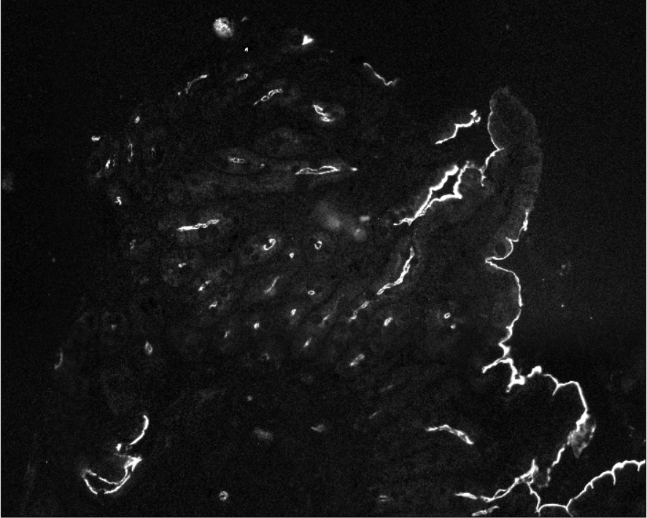
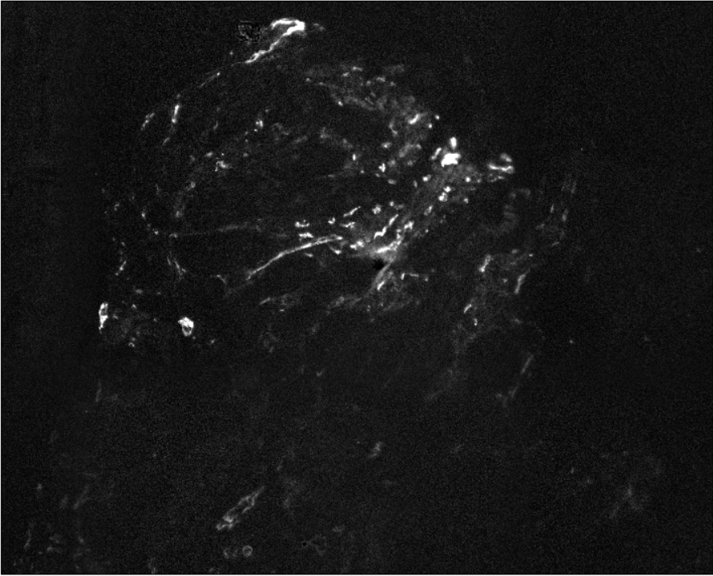
Round 6:
CST PDGF Beta Receptor AF 555 (79304BC) - 1:100 dilution
Leica Thunder
Abcam CD31 AF647 (ab218582) - 1:20 dilution
Multiplex Run 12_12_23
SCB CD10 AF 488 (sc-46656 AF488) - 1:50 dilution
Multiplex Run 12_12_23

Slide 8
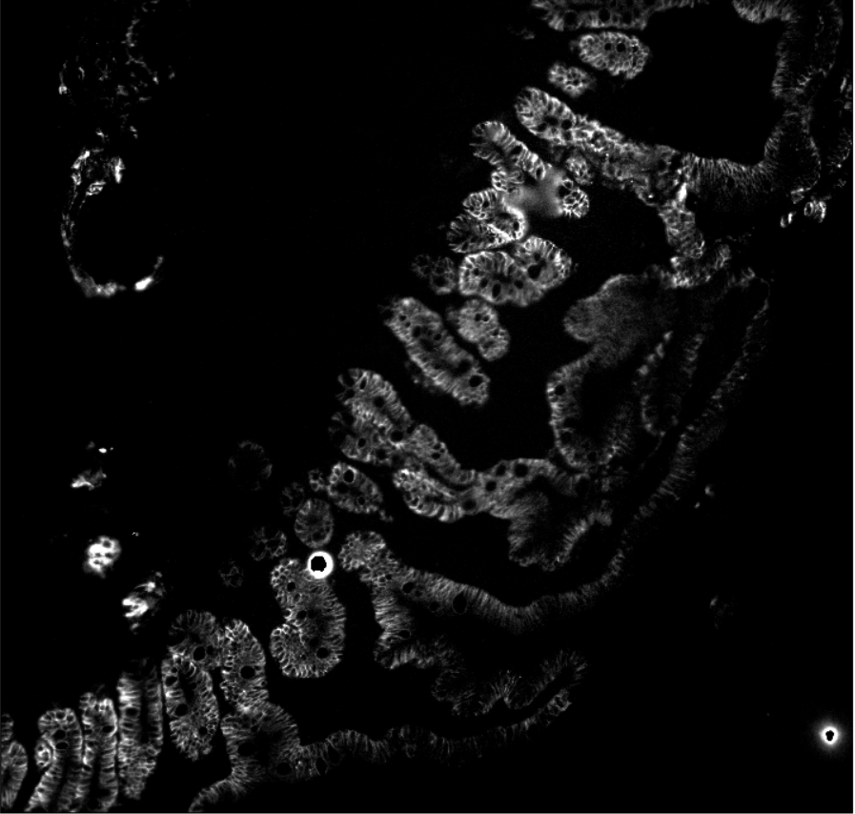
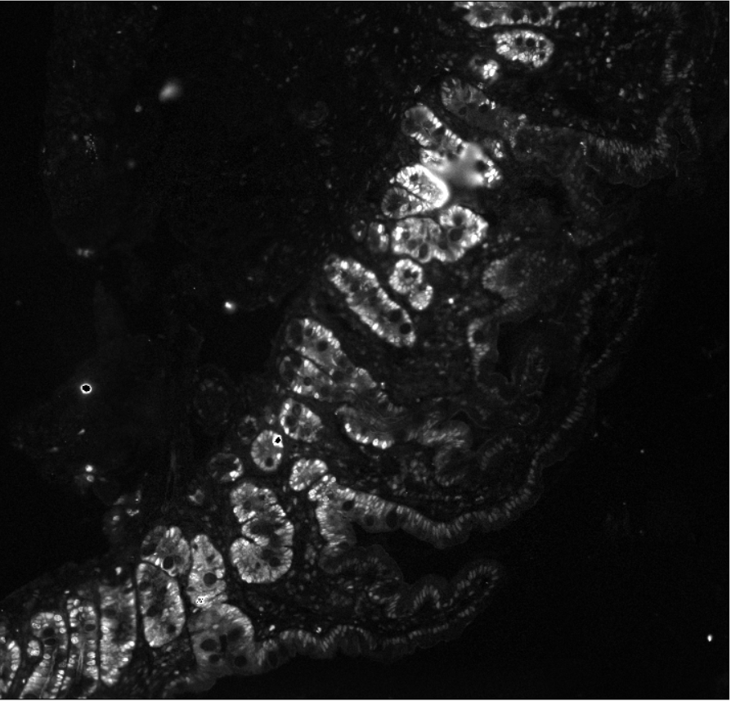
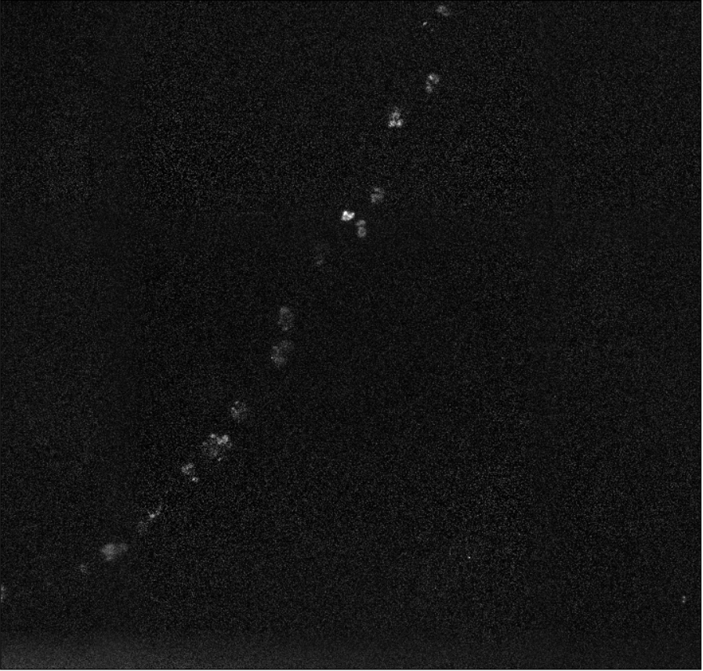
Round 7:
Abcam EpCAM AF 555 (ab275122) - 1:100 dilution
Multiplex Run 12_12_23
Novus Lysozyme AF 647 (NB100-63062AF647) - 1:100 dilution
Multiplex Run 12_12_23
SCB PCNA AF 488 (sc-56 AF488) - 1:20 dilution
Multiplex Run 12_12_23

Slide 9
Cellpose Overview

Slide 10
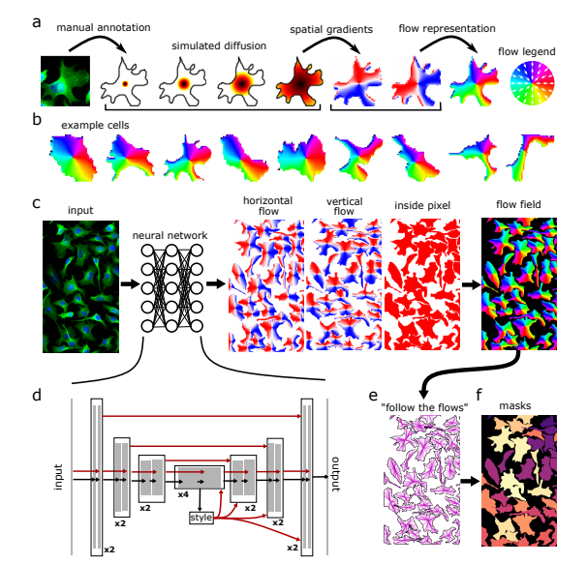
Cellpose Architecture
“generalist algorithm for cellular segmentation”
Neural network based on general U-net architecture with some modifications
Replace feature concatenation with direct summation during upsampling pass to reduce number of parameters
Replaced standard U-net building blocks with residual blocks
Doubled depth of network
Cellpose: a generalist algorithm for cellular segmentation | bioRxiv
Model architecture from original paper

Slide 11
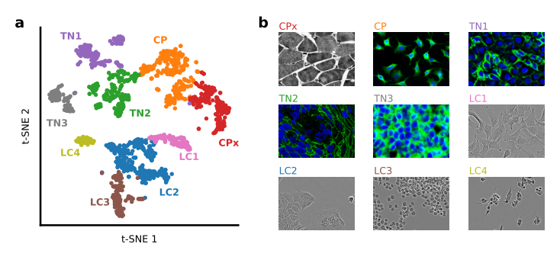
Cellpose 2.0
Differing styles of annotation in various datasets - expanded from 1 model to 9 models
Introduces human-in-the-loop in order to retrain models
Documentation: cellpose — cellpose 2.2.2-17-gbe14e5f documentation
Paper: Cellpose 2.0: how to train your own model | bioRxiv

Slide 12
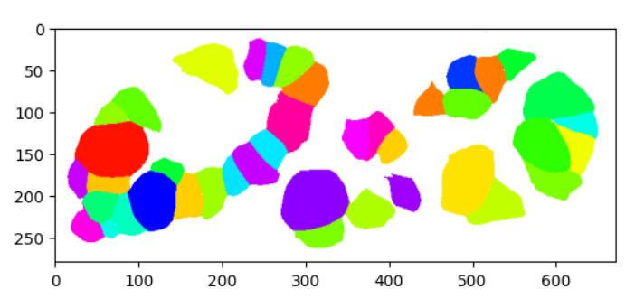
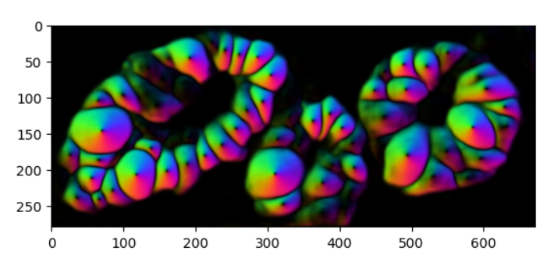
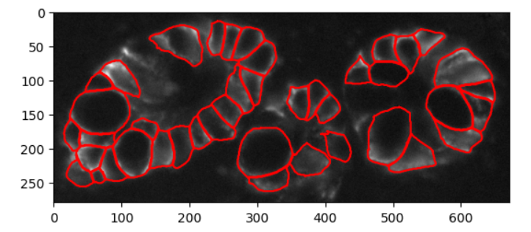
Cellpose Outputs
Outputs a _seg.npy file which is a dictionary containing:
[‘outlines’, ‘colors’, ‘masks’, ‘chan_choose’, ‘filename’, ‘flows’, ‘ismanual’, ‘manual_changes’, ‘model_path’, ‘flow_threshold’, ‘cellprob_threshold’]
Outputs — cellpose 2.2.2-17-gbe14e5f documentation
Notes:
Note: different compared to documentation on cellpose website

Slide 13
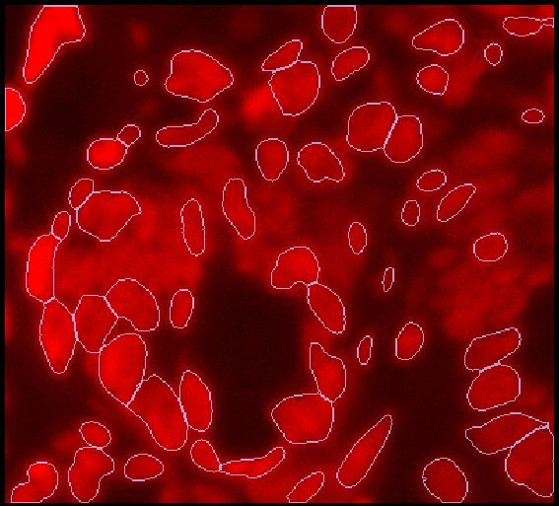
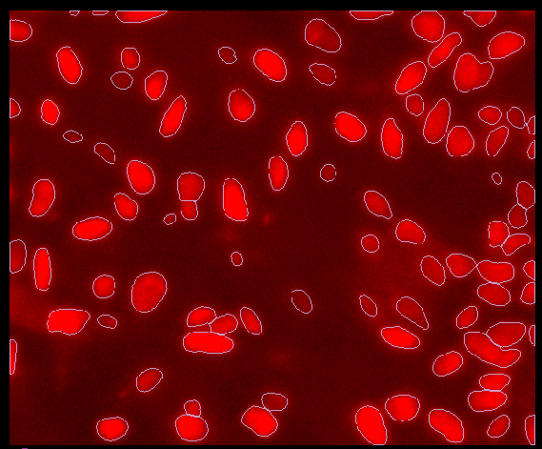
DAPI/Nuclei Staining Results
Default settings for flow_threshold and cellprob_threshold

Slide 14
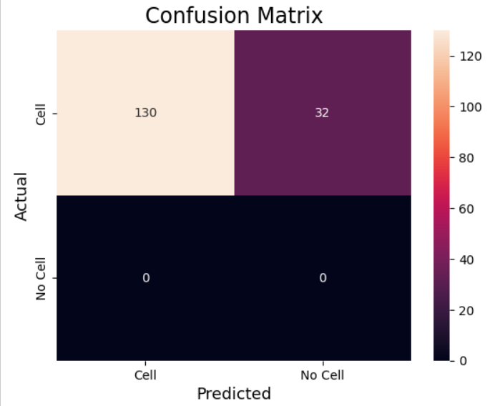
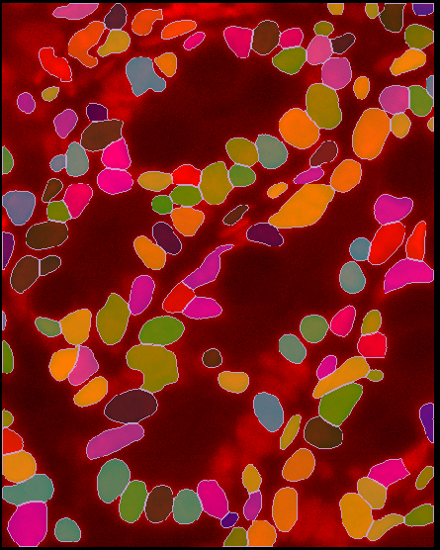
DAPI Results
Model = nuclei
Using just red channel to segment
Cell diameter = 29.5
Flow_threshold = 0.4
Cellprob_threshold = 0
Accuracy = 0.802
Precision = 1.0
Recall = 0.802
F1 Score = 0.890

Slide 15
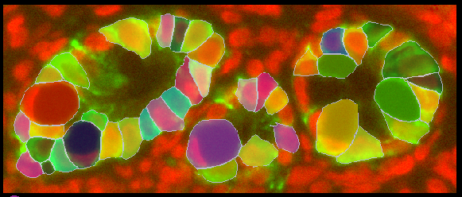
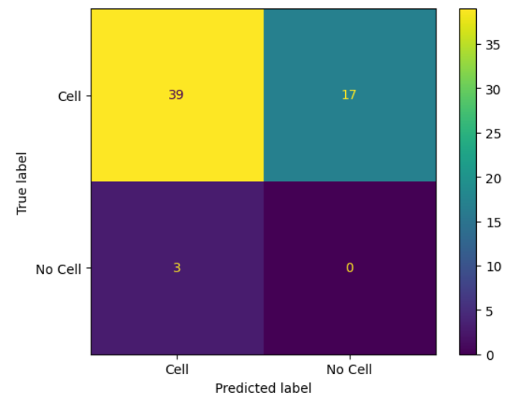
Epcam Results
Model = Cyto
Using just green channel to segment
Cell diameter = 37.8
Flow_threshold = 0.4
Cellprob_threshold = 0
Accuracy = 0.661
Precision = 0.929
Recall = 0.696
F1 Score = 0.796

Slide 16
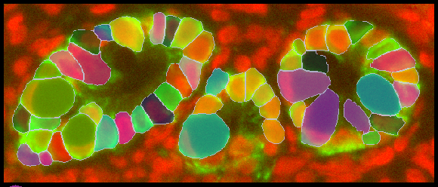
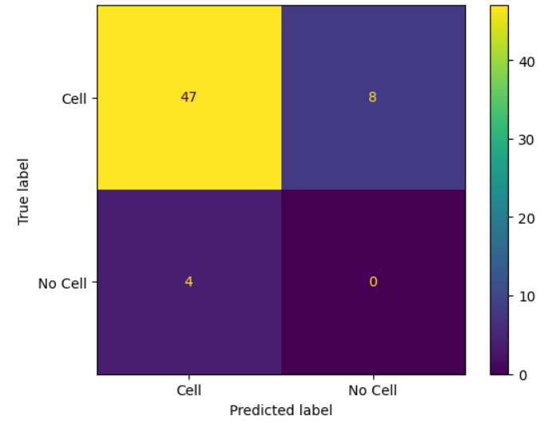
EpCAM Retraining Results
Model = EpCAM_cyto (user-made)
Using just green channel to segment
Cell diameter = 34.14
Flow_threshold = 0.4
Cellprob_threshold = 0
Accuracy = 0.797
Precision = 0.921
Recall = 0.855
F1 Score = 0.887
Notes:
Retrained with 127 ROIs (89 manual ROIs)
Paper claims 100-200 manually segmented ROIs are sufficient to achieve near-maximal accuracy

